Slide 1
Team Y_2
Jordan Aronson, Shantanu Kulkarni, Haodong Mo, Ben Phoebus, Gaurang Rustagi, Malavika Thakore

Slide 2
Business Value
An application to help travellers travel safely in a post-COVID-19 world
Input your travel itinerary to get a summary of disease outbreak reports in places you are going
Understand restrictions such as lockdowns, mask requirements, and travel bans ahead of time
More convenient than manually researching by going to lots of news sites and local outlets, potentially from around the world in different languages

Slide 3
Analytics Platform

Slide 4
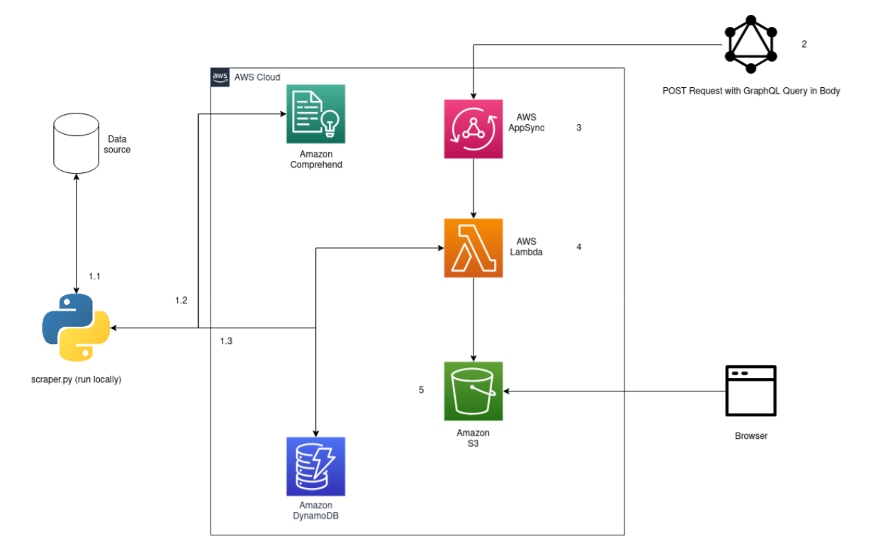
Technical Architecture
We are using AWS extensively
Python script (On one server) acts as a scraper, which populates our DynamoDB database (on AWS)
Lambda node running to serve as our backend
GraphQL receives data from backend

Slide 5
Demonstration

